Slide 1
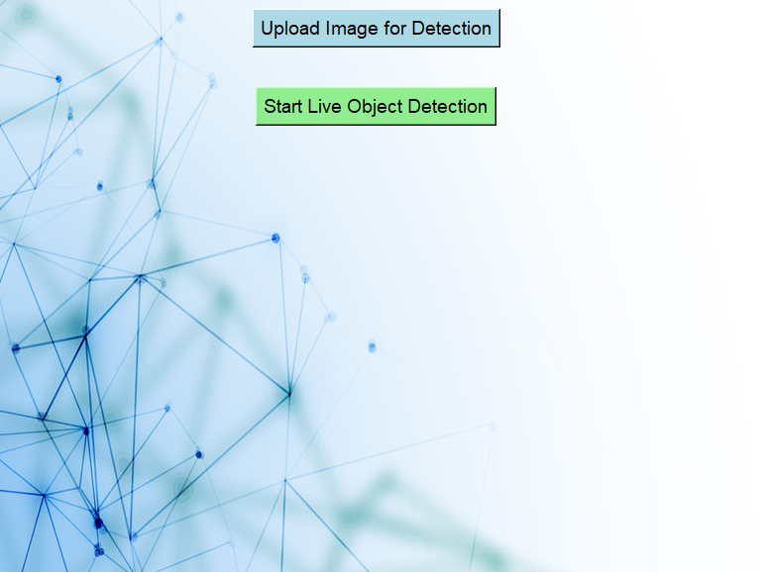
Object Detection
User Manual
Aarna Dwivedi

Slide 2

Acknowledgements
I would like to say thank you to Mr. Das and Dr. Kahn for this amazing opportunity. I have learnt so much in this internship and it has been an invaluable experience for me. I am very thankful for this opportunity and not only have I learnt a lot but I have also had a lot of fun doing so!

Slide 3

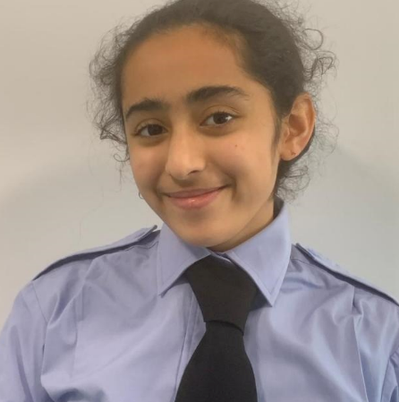
About Me..
My name is Aarna Narad-Dwivedi. I am in Year 9 and I have always loved STEM, and in particular AI. I am currently a Physics ambassador at my school. I am also a Computer Science ambassador from Year 7 to Year 9. I was also a Maths ambassador.
photograph

Slide 4
My Internship Journey
I have loved my internship journey - I have learnt so much from programming to CNN Models and Decision Trees. I have earned a few Rockstar badges in the internship and I have come out of each session having learnt something new. I am incredibly grateful for this opportunity and I had so much fun as well as learning a lot. I am very excited to present this project and I would like to thank Dr. Kahn and Mr. Das for this incredible internship.

Slide 5
About App..
My project is aimed at helping the visually impaired
to overcome challenges they face in their daily lives. It can describe objects in live detection or in static images. I chose this project as I hope it can help people in
the future.

Slide 6
How do I use the App?

Slide 7
You can choose whether you would like to upload an image for detection to or to start live object detection

Slide 8
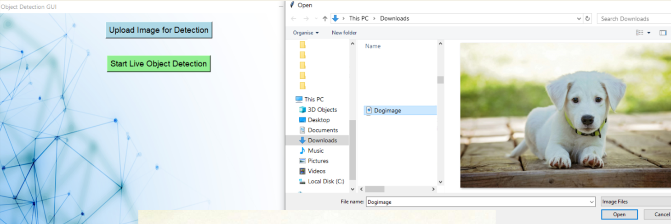
If “Upload Image for Detection” is clicked, a prompt will appear asking you to upload an image for detection. You can select any image file you would like to be detected.

Slide 9
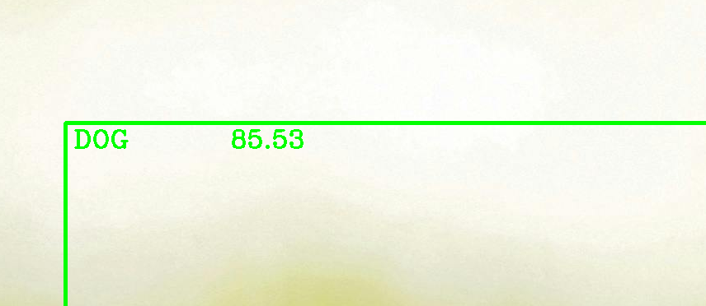
Object detection will begin and you can upload another image or start live detection by clicking on another option in the home screen.

Slide 10
You can choose whether you would like to upload an image for detection to or to start live object detection

Slide 11
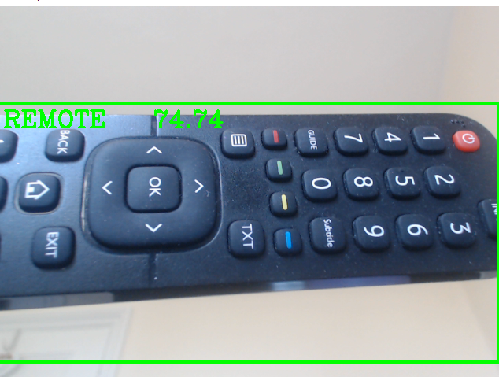
If “Start Live Detection” is clicked, your camera will start and object detection will begin! To finish you can press “Q” and the camera will stop. You can upload an image for detection or start live detection again by clicking on another option in the home screen.

Slide 12
Thank you!

